Slide 1



Sylva project
WG2 - Sylva Validation Center
Luis Velarde WG2 leader
September 2025
A fundamental step to Telco Cloud & Edge homogenization and sustainability
Every cloud has a SYLVA lining

Slide 2
Why WG-2?
Introduction to Validation Center
Verify that workloads can work on top of Sylva as a reference cloud native stack
Validate the use of Sylva capabilities by workloads
Confirm that workloads follow the cloud native principles and can work on different configurations of Sylva
Keep a registry of validated workloads
Verify that new flavours in Sylva incorporate all the expected capabilities (e.g.: CAPI, multitenancy, support openstack and baremetal, support for SR-IOV configuration, Kepler, …)

Slide 3
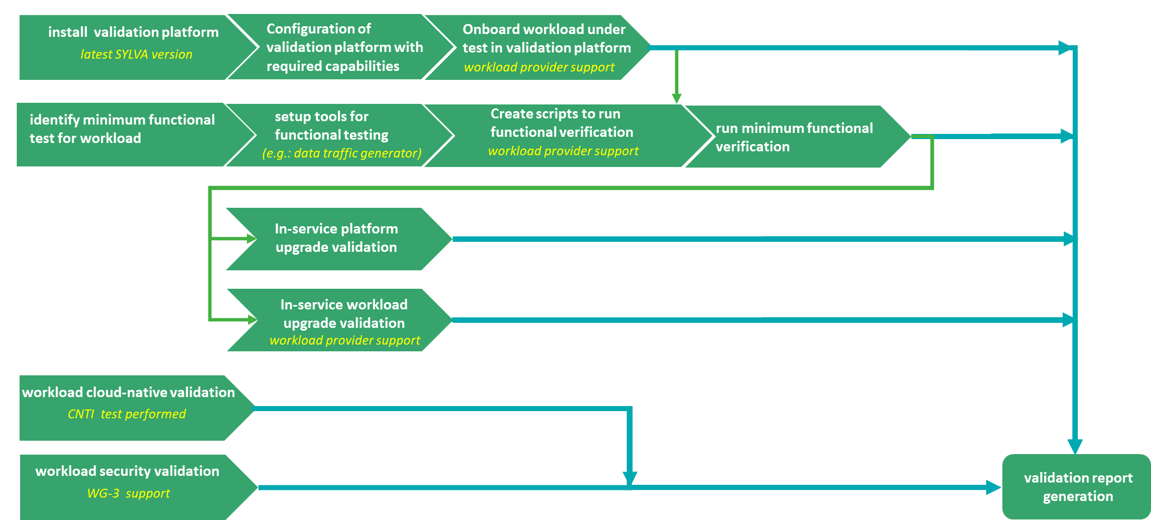


How?
Workload validation cycle steps

Slide 4

How?
Workload validation cycle steps
Repeat in a different Sylva configuration/flavour
(cloud-native behaviour)

Slide 5
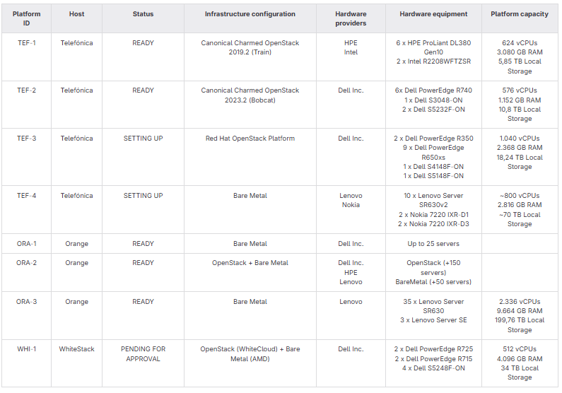


Where?
Validation platforms
2➔4
3
0➔1
Configurations Vs Flavours
https://gitlab.com/sylva-projects/validation_center/-/blob/main/validation-platforms/validation-platforms.md?ref_type=heads

Slide 6







When?
Validated workloads & validation backlog
Others
Workloads Validated
5G PCF
5G SIG
CASA SMF/NRF
Fortinet cFOS
Obvios 5G Core
Unysis cUVMS
Druid 5G Core
F5 BIG-IP
Titan.ium EDNS
OpenX. PowerDNS
VSR (x2)
5G Distrib UPF
5G SIG
5G SDM
5G SDM
5G SDM
Telco Service Orchestrator
ESOA (Orchestrator)
19 workloads already validated!!
Workload Backlog
    Juniper cSRX
    F5 BNK
    Juniper JCNR
    Nvidia Toolkit
    Fogsphere Video Analytics
    …
https://gitlab.com/sylva-projects/validation_center/-/blob/main/workloads-validation-backlog.md?ref_type=heads

Slide 7
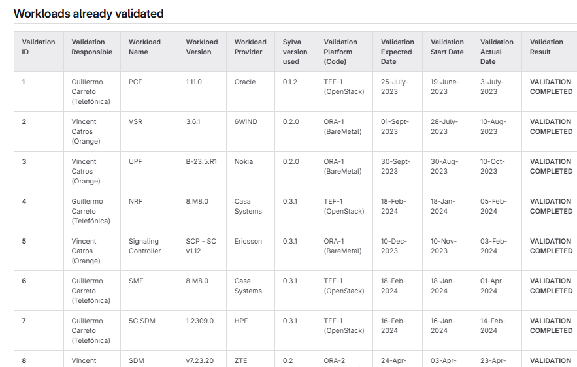
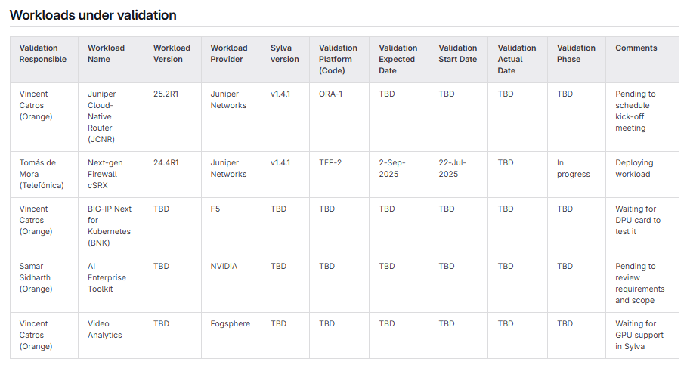
When?
Validated workloads & validation backlog
https://gitlab.com/sylva-projects/validation_center

Slide 8
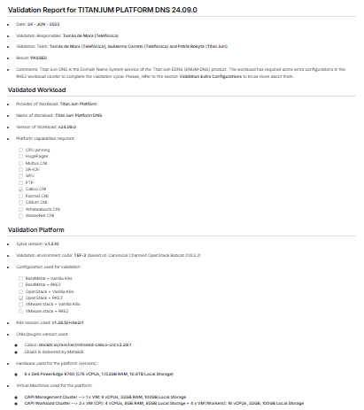
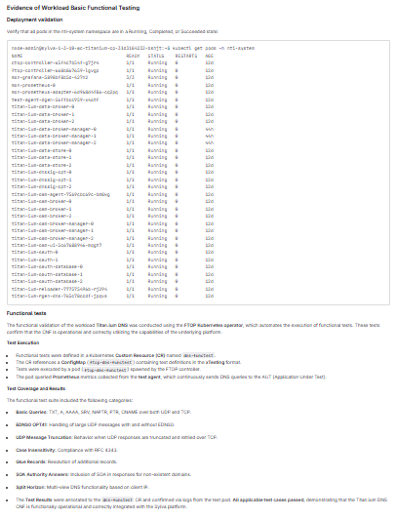
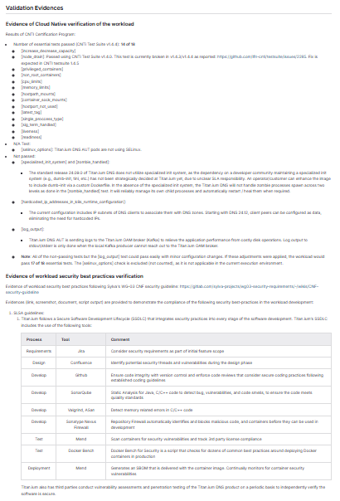
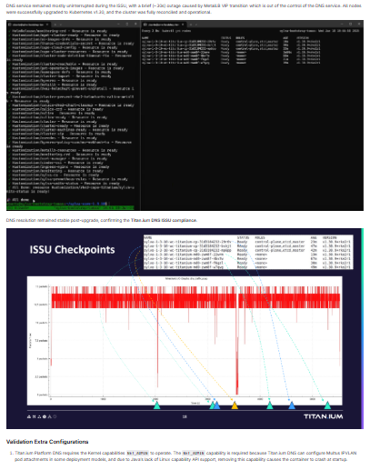
What?
Validation report
A validation report contains information about
  Workload (e.g name, version, provider, etc,)
  Validation platform (e.g. Sylva version, configuration, etc.)
  Evidence of Cloud Native verification (CNTi Test Suite)
  Evidence of security best practices verification (WG-03)
  Evidence of workload deployment
  Evidence of basic functional testing
  Evidence of in service upgrade support
References
  Validation report template
  Validation reports (BareMetal)
  Validation reports (OpenStack)
  Example of complete validation report
workloads-validations/OpenStack/Titan.ium_Platform_DNS_24.09.0/ValidationReport-Titan.ium_Platform_DNS_24.09.0.md · main · Sylva-projects / WG02 Validation Center · GitLab

Slide 9

Thank you

