Slide 1


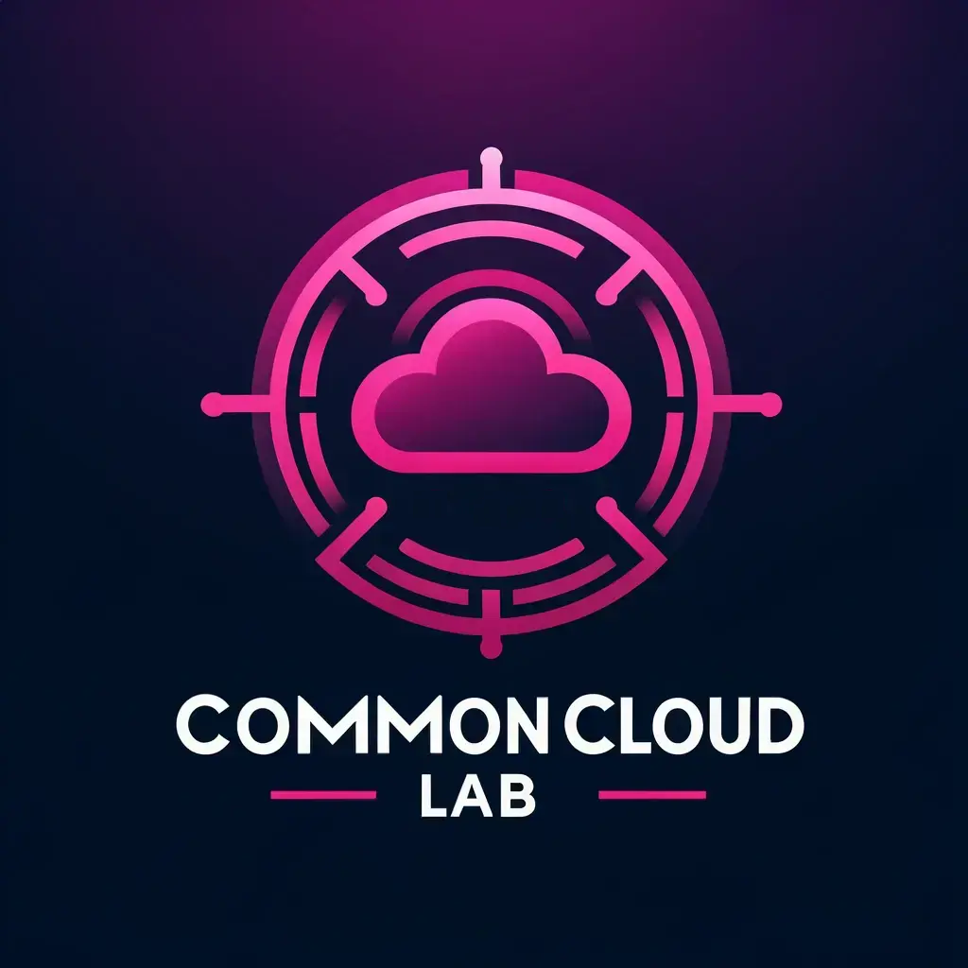

Last update on cLab development… Marin Komadina, Automation and Orchestration Platform
CNF to infra dependencies
Weeks 26-29 2023.

Slide 2
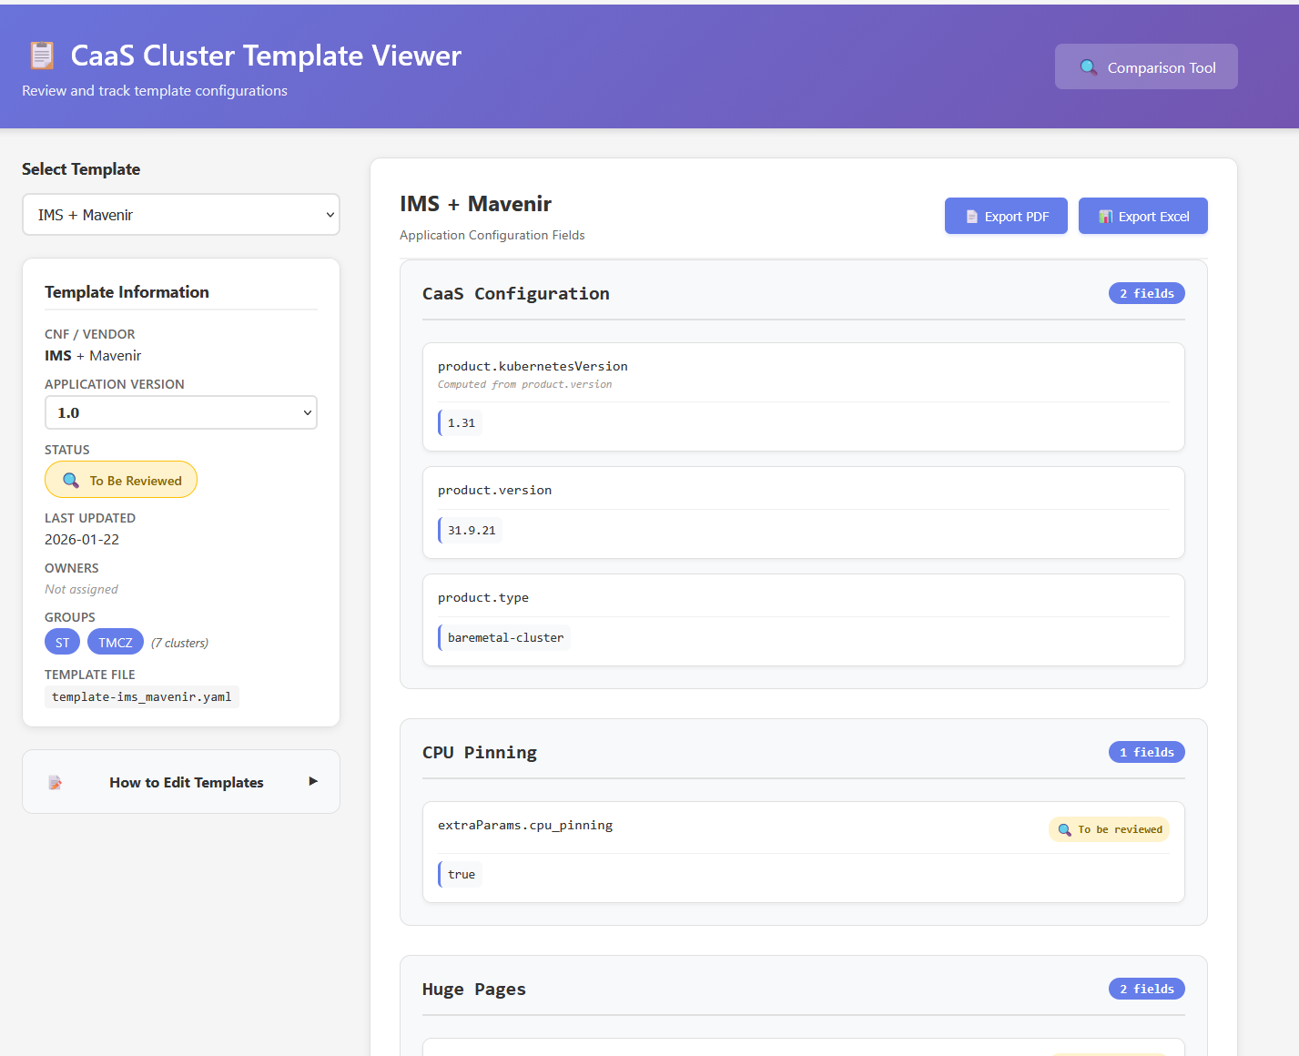
CNF cluster templates

Slide 3
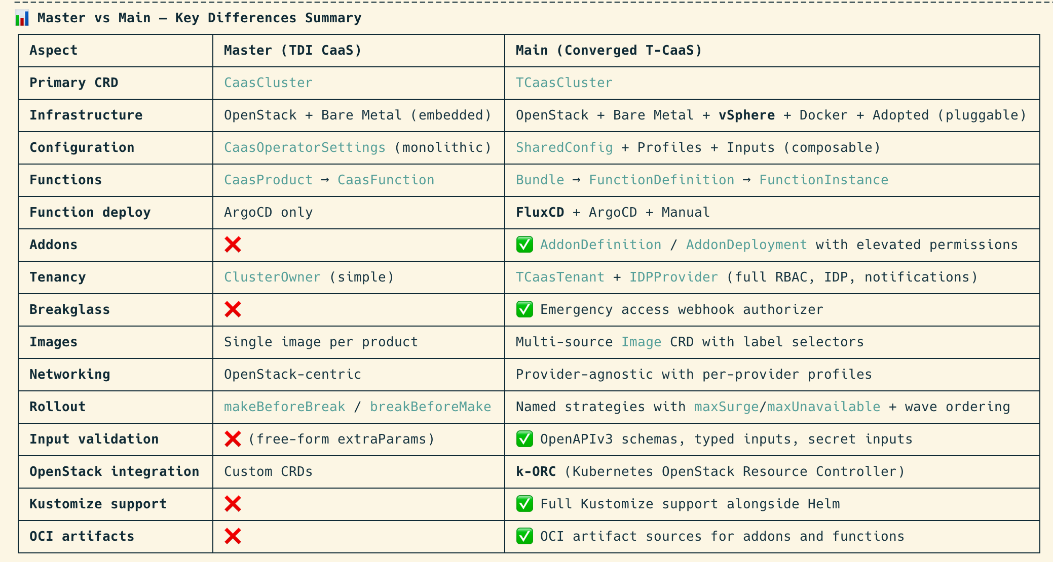
Provisioning Operator

Slide 4
Full list of features
Infrastructure Management (OpenStack + Bare Metal) The operator manages the full lifecycle of Kubernetes clusters on both OpenStack and Bare Metal infrastructure via Cluster API (CAPI). From a single CaasCluster CR, it automatically creates and reconciles: OpenStack resources: - OpenStack User (via Juice API) - OpenStack Project (tenant) with quotas - OpenStack Flavors (master, worker, medium, large, xlarge, xxlarge) - OpenStack Images (control plane & worker images, with MD5 verification) - OpenStack Networks, Subnets, Routers - OpenStack Floating IPs - OpenStack Security Groups - OpenStack Server Groups (anti-affinity) - OpenStack Ports (including trunk ports with sub-ports) - OpenStack Quota management (auto-adjusted based on cluster needs) Bare Metal resources: - DCIM (NetBox) integration — discovers and reserves physical servers - Redfish/BMC support (Lenovo and HP servers) - Deploy image (ISO) generation for PXE/bare-metal provisioning - Ramdisk commands for pre-boot customization - Disk selection by minimum size (minDiskSize) - Failure domain balancing (none, best-effort, strict) across availability zones
Networking The operator has a very rich, declarative networking model with these network provider types: - Multiple networks per cluster (e.g., separate DTH, OAM, internet networks) - Per-worker-group networking — different network configs for control plane vs each worker group - Network Profiles — reusable, immutable network templates (NetworkProfile CRD) - Templating with {{ .ClusterName }}, {{ .MachineName }} and {{ (get "resource-name").Id }} dependency resolution - Netplan generation — injects per-machine netplan config into cloud-init automatically via the Shim mechanism - OCCM load balancer classes per network — enabling multi-network service exposure - IPv6 support (RA mode, address mode)
Operational Features - Maintenance mode — pause reconciliation with a reason annotation - Dry-run mode — simulate changes without applying them, showing a diff summary - Update plans — status shows what changes will trigger control plane or worker re-rolls - Sequential or parallel worker group upgrades (overallWgStrategy) - Worker group autoscaling (min/max replicas) - Ceph storage class configuration for bare metal - Telemetry for bare-metal deployment status tracking - Validating & Mutating webhooks — extensive input validation - DCIM integration — registers clusters, devices, and config contexts in NetBox
Kubernetes & Node Configuration Via CaasComponentConfig (backed by CAPI's KubeadmConfigSpec), the operator configures: - Kubernetes version management - preKubeadmCommands / postKubeadmCommands — arbitrary shell commands run before/after kubeadm (with templating support), used for kernel parameters, sysctl settings, package installation, etc. - Kubelet extra args per worker group (kubeletExtraArgs) - Node labels per worker group or control plane (nodeLabels) - Node taints per worker group or control plane (nodeTaints) - OIDC configuration (issuer URL, client ID, CA, claims, groups) - CoreDNS skip (managed by CaaS functions instead of kubeadm) - KubeProxy skip (managed by CaaS functions instead of kubeadm) - ExtraParams — open-ended dynamic map passed through to helm chart values (e.g. kube-proxy cluster FQDN) - Alternate SANs for API server certificates (alternateNames) - KubeVIP support for virtual IP-based API access - Deployment strategies: makeBeforeBreak or breakBeforeMake (per cluster or per worker group) - Feature gates in component configs (e.g. RoleAndWorkerGroupNodeLabels, ProperMachineInputs) Application Lifecycle (CaasFunctions & CaasProducts) - CaasProduct — defines a complete cluster "product" (K8s version, OS images, list of functions, actions, component config) - CaasFunction — declares Helm charts to deploy on clusters, with: - Dependency resolution (dependsOn, requires, provides) - Local (mgmt cluster) or remote (customer cluster) deployment - ArgoCD integration for GitOps-based deployment - DNS record creation per function - Custom sync options (replace, create namespace)

