Slide 1


Sylva project
NFD & Sylva Image Compatibility
March 2026
Leo Yang (@Xunli-Yang, xunliyang.dev@gmail.com )
Joe Huang (@joehuang999, joehuang.sweden@gmail.com)

Slide 2



Issue 1：how to align the cluster configuration with CNF needs
Mismatch between CNF requirements and cluster configurations (eg: resource & network configuration)
CNF
Cluster1
Cluster2
1.Define the CNF needs
2.Match the CNF needs with cluster configurations
Notes:
什么是NFD？Node Feature Discovery (NFD)是Kubernetes的一个插件，用于自动检测节点的硬件特性和系统配置，并将这些信息以标签(labels)的形式添加到Kubernetes节点对象上。

Slide 3

Issue 2：To meet telco mission critical requirements…
Vendor Consolidated System
Disaggregated System
Telco APP
99.999%？
Latency?
SLA?
……
Telco APP
Vendor A
CaaS
container
99.999%
Latency
SLA
etc.
container
CaaS+OS
Vendor B
OS
Server
99.9%
Hardware
Vendor C
Storage
Network
Operator production
missing puzzle
Function
Compatibility
Performance
Resilence
Reliability
Availability
Fault Tolerence
Diagnosbility
…
Vendor In-house tests:
>10 times traffic flow test, survival from traffic storm
250 syscall / xx pseudo file systems access
……
How to make sure Telco service meet strict requirement?

Slide 4
Solution: Deliver image compatibility from vendor to operators
image compatibility
……
…….,,,,,,,
……..
Telco APP
1.Define the CNF needs
container
vendor creates compatibilities for well-tested 3rd platforms/components
Vendor B CaaS+OS
vendor delivers telco app and image compatibility to operator 2
Vendor C Hardware
Operator 2
(validate compatibility, acceptance test, interworking test etc)
image compatibility
Telco APP
……
…….,,,,,,,
……..
container
image compatibility
vendor delivers telco app and image compatibility to operator 3
……
…….,,,,,,,
……..
Telco APP
container
vendor
Vendor D CaaS+OS
Vendor E Hardware
Compatibility determines more than just whether a container can run; it also dictates mission critical factors like latency, performance, and SLA etc in Telco context
Operator 3
(validate compatibility, acceptance test, interworking test etc)

Slide 5
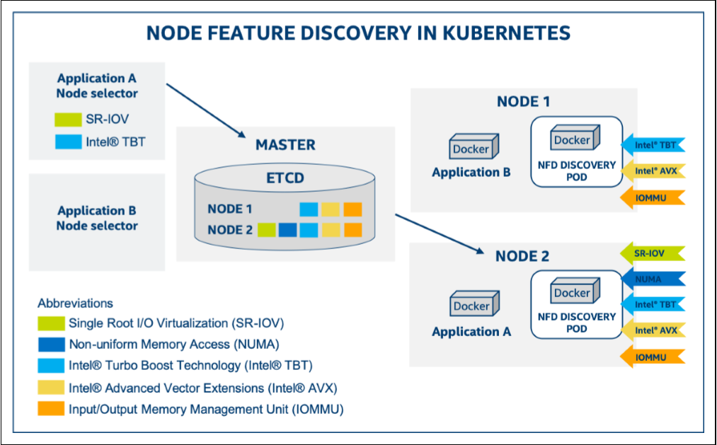
Node-Feature-Discovery (NFD)
feature.node.kubernetes.io/
Not all features are labelled
How to define the CNF needs with complex rules
Notes:
什么是NFD？Node Feature Discovery (NFD)是Kubernetes的一个插件，用于自动检测节点的硬件特性和系统配置，并将这些信息以标签(labels)的形式添加到Kubernetes节点对象上。

Slide 6
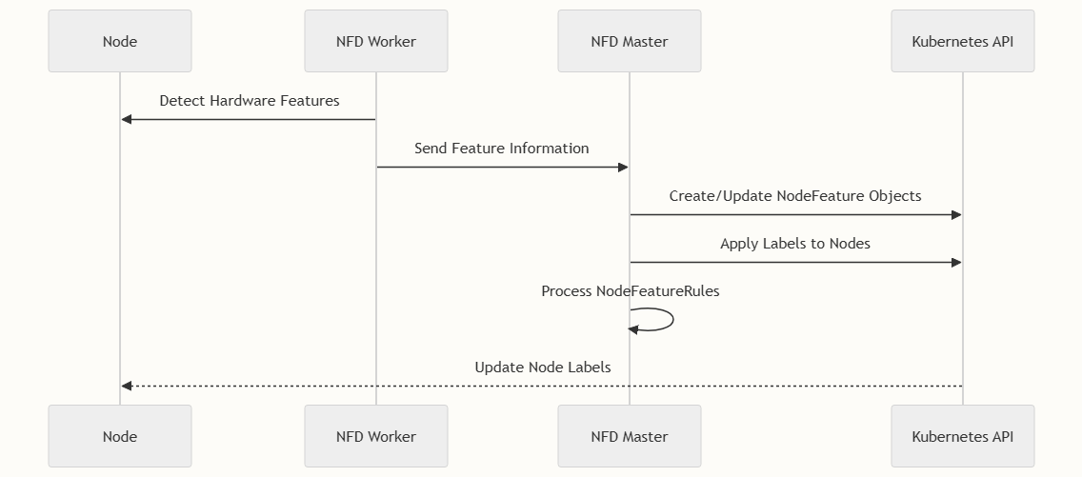
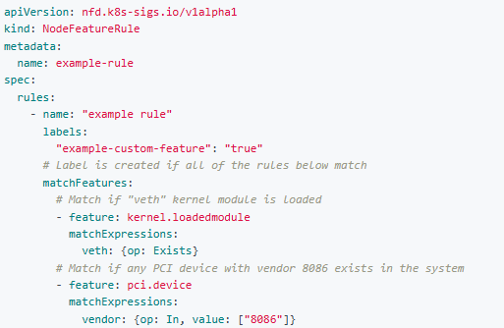
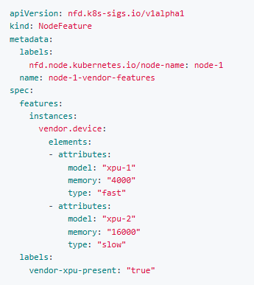
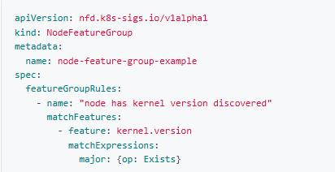
Node-Feature-Discovery (NFD) CRD
Define the rules that match features
NodeFeatureRules
NodeFeatureGroup
NodeFeature
Group by feature rules
All node features discovered by nfd-worker
Notes:
Node Feature Discovery (NFD) is a Kubernetes add-on for detecting hardware features and system configuration. Detected features are advertised as node labels. NFD provides flexible configuration and extension points for a wide range of vendor and application specific node labeling needs.

Slide 7
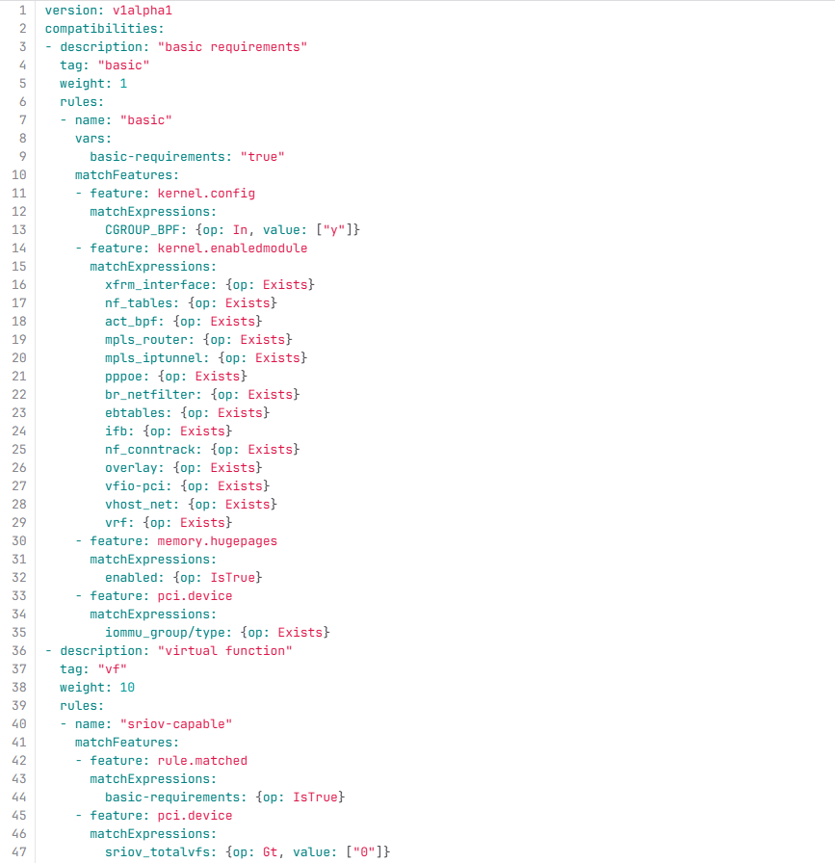
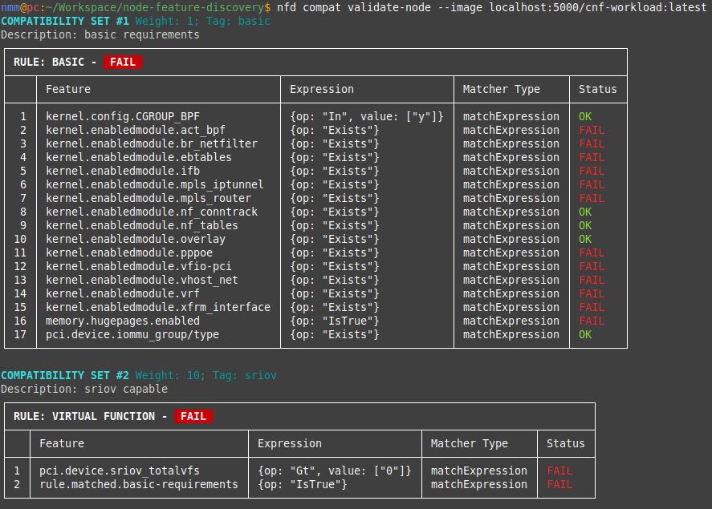
NFD V0.17 New Feature -Image Compatibility
Match features
?
NFD client tool allows for node validation based on an image's compatibility artifact.
When a need arises to assess the fit of an image to a host, the tool can discover the artifact points to the image and verify compatibility of an image to a node before deployment.
https://kubernetes-sigs.github.io/node-feature-discovery/master/usage/image-compatibility.html
Notes:
https://kubernetes.io/blog/2025/06/25/image-compatibility-in-cloud-native-environments/
To streamline compatibility validation, we implemented a client tool that allows for node validation based on an image's compatibility artifact. In this workflow, the image author would generate a compatibility artifact that points to the image it describes in a registry via the referrers API. When a need arises to assess the fit of an image to a host, the tool can discover the artifact and verify compatibility of an image to a node before deployment. The client can validate nodes both inside and outside a Kubernetes cluster, extending the utility of the tool beyond the single Kubernetes use case.

Slide 8


Image compatibility integration in Sylva validation center
Community developed artifacts
NFD image compatibility test automation scripts
version: v1alpha1
compatibilities:
- description: "basic requirements"
tag: "basic"
weight: 1
rules:
- name: "basic"
vars:
basic-requirements: "true"
matchFeatures:
- feature: kernel.config
matchExpressions:
CGROUP_BPF: {op: In, value: ["y"]}
- feature: kernel.enabledmodule
matchExpressions:
xfrm_interface: {op: Exists}
nf_tables: {op: Exists}
act_bpf: {op: Exists}
mpls_router: {op: Exists}
mpls_iptunnel: {op: Exists}
pppoe: {op: Exists}
br_netfilter: {op: Exists}
ebtables: {op: Exists}
ifb: {op: Exists}
nf_conntrack: {op: Exists}
…….
image compatibility artifact
CNF
image
test container
cnf_image_compatibility_tests.py
create validate jobs
job
pull
job:
nfd
compat
validate
Functest
XTesting
Framework
Sylva Workload Cluster (K8S)
worker nodes
Artifact public disclosure is optional, respecting vendors' business confidentiality
https://gitlab.com/sylva-projects/validation_center/-/tree/main/workload-validation-scripts/xtesting-cnf_image_compatibility_tests
https://gitlab.com/sylva-projects/validation_center/-/tree/main/oci-image-compatibility-artifacts

Slide 9
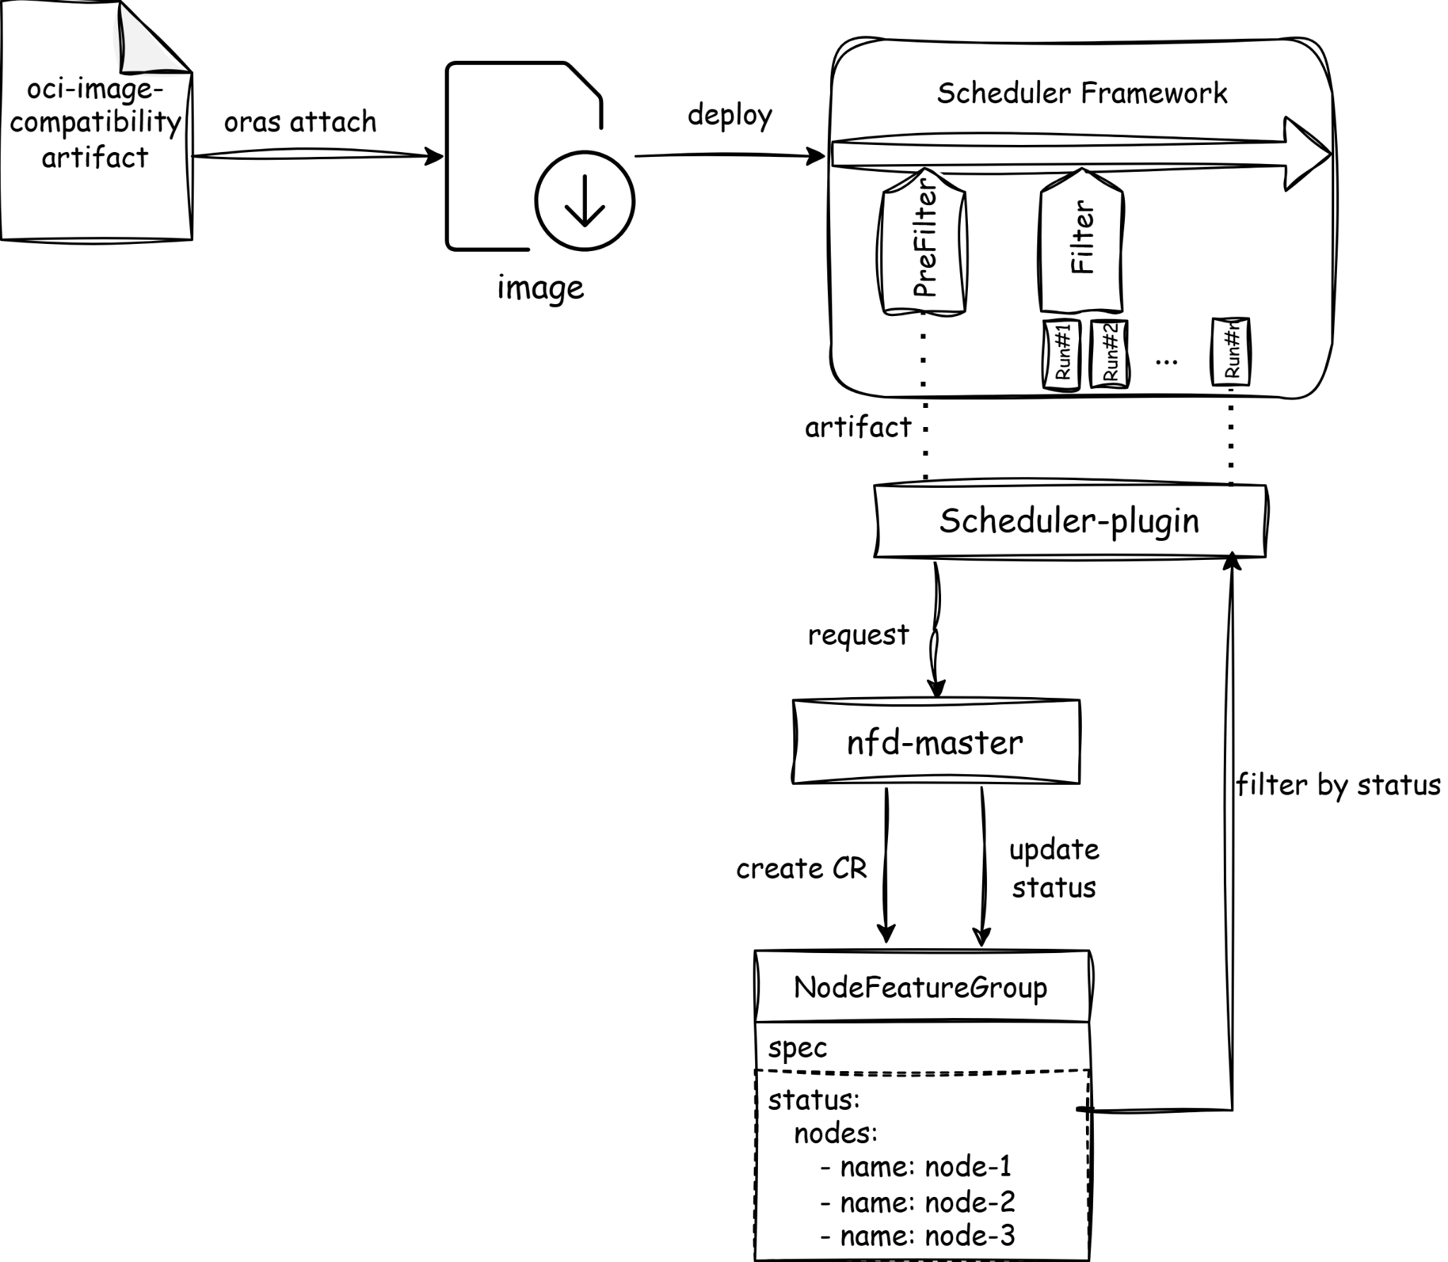
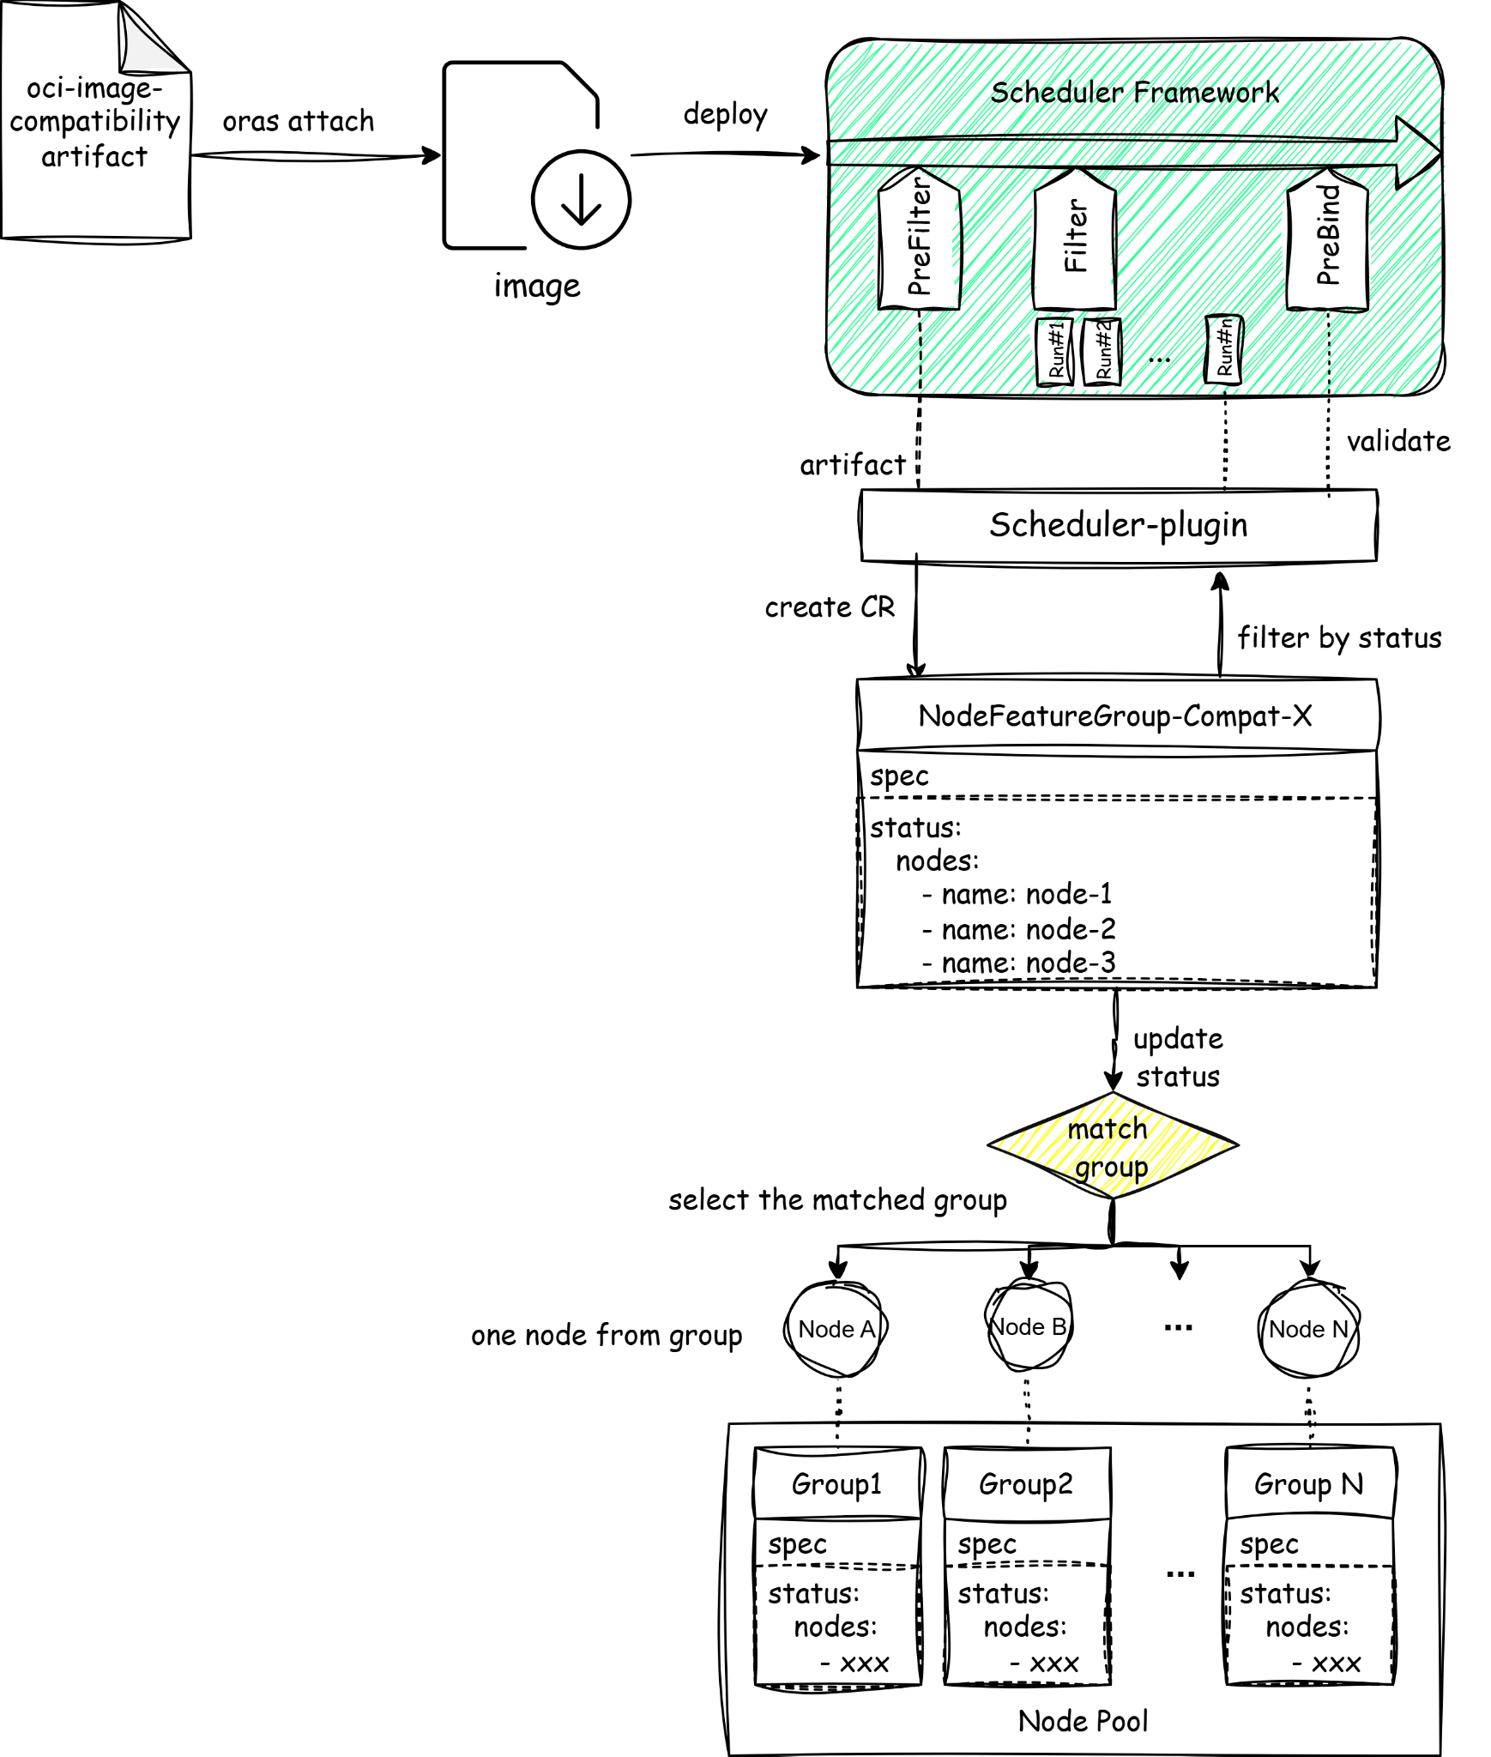
Image Compatibility Scheduler Plugin Proposal
Basic Implement:
NodeFeatureGroup groups nodes by compatibility rules
Advanced
large-cluster solution
pre-grouping
KEP:https://github.com/kubernetes-sigs/node-feature-discovery/pull/2403
MVP demo:https://github.com/Xunli-Yang/image-compatibility-scheduler

Slide 10
Possible ways of enhancement
Image compatibility tool in Sylva GitOps
Compatibility artifact can quickly optimize validation of the CNF
Provide definition of CNF needs
Image compatibility scheduler plugin in Sylva GitOps
Schedule CNF pods to nodes that satisfy the needs
Artifact is optional and compatibility
How…

Slide 11
Thanks !

