Slide 1


Application artifacts for GitOps architectures
Feedback from Telefónica based on internal work in Open Source MANO
Gerardo García (Telefónica)

Slide 2
About
Open Source MANO

Slide 3

Manage Infrastructure, Platforms and Applications across Cloud Platforms
in the easiest way

Slide 4


Since Release SIXTEEN, OSM scope and architecture have been substantially extended
Classical OSM
NFV-like operations
Day-1/2 actions
Imperative Operations

Slide 5


Since Release SIXTEEN, OSM scope and architecture have been substantially extended
Classical OSM
NFV-like operations
Day-1/2 actions
Configuration as Data
Kubernetes-like operations
Continuous Sync & Reconciliation
Imperative Operations
Declarative Operations
🆕

Slide 6






Workflow for declarative operations
NBI calls
OSM NBI
NBI operations for first-class citizens:
clusters, profiles, OKA, KSU, app instances
OSM LCM
Internal operations are defined with
Argo Workflows, which lead to commits
in the Git repos
1
2
Mgmt cluster
GIT repos
Workflow engine
CD operator
Workload
cluster
Observe
3
Calculate diff
Adjust
CRDs
Observe
3
Calculate diff
Adjust

Slide 7





Continuous Reconciliation of Intents
AKS01
Adjust
MANAGEMENT CLUSTER
Observe
Mgmt Cluster Intent
Observe
Calculate diff
AKS01 Cluster
CLOUDS AND SITES
GKE01 Cluster
Adjust
Calculate diff
Adjust
GKE01
Observe
Calculate diff
SOURCE(S) OF TRUTH

Slide 8
Continuous Reconciliation of Intents
Observe
AKS01
Calculate diff
Adjust
AKS01 Cluster Intent
Adjust
Infra Controllers
MANAGEMENT CLUSTER
Infra Configs
Apps
Observe
Mgmt Cluster Intent
Observe
Calculate diff
AKS01 Cluster
CLOUDS AND SITES
GKE01 Cluster
Adjust
Calculate diff
Adjust
GKE01 Cluster Intent
Infra Controllers
GKE01
Infra Configs
Apps
Observe
Calculate diff
Observe
SOURCE(S) OF TRUTH
Calculate diff
Adjust

Slide 9


Continuous Reconciliation of Intents
Observe
AKS01
Calculate diff
Adjust
AKS01 Cluster Intent
Adjust
Infra Controllers
MANAGEMENT CLUSTER
Infra Configs
Apps
Observe
Mgmt Cluster Intent
Observe
Calculate diff
AKS01 Cluster
CLOUDS AND SITES
GKE01 Cluster
Adjust
Calculate diff
Adjust
GKE01 Cluster Intent
Infra Controllers
GKE01
Infra Configs
Apps
Observe
Calculate diff
Observe
SOURCE(S) OF TRUTH
Calculate diff
Adjust

Slide 10
Git repos, artifacts and intents in OSM

Slide 11
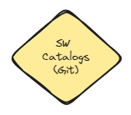
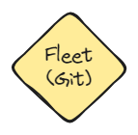
Git repo structure for FluxCD in OSM
FluxCD is opinionated about the structure of a git repo.
Structure oriented to create references and dependencies.
  Similar to the way Systemd works with references.
Two repos in OSM:
  sw-catalogs: Catalog of workloads (applications, controllers, etc.)
    This repo is where vendor artifacts are stored
  fleet: Objects to be created in the cloud (the intents), referencing manifests
  in the sw-catalogs
    In practice, in all the cases we have kustomizations pointing to objects in sw-catalogs.

Slide 12
Application artifacts in OSM
OKA (OSM Kubernetes Application)
The simplest OKA consists of just manifests and templates
templates/
manifests/
…
…
Kustomization #1
…
…
Kustomization #2
…
…
Kustomizations that determine how the manifests/ folder is parametrized, transformed and exposed.
Other resources (optional).
K8s resources, sufficient for a valid instantiation.
Intended as read-only.

Slide 13

How an intent is generated in OSM
INTENT MODIFICATIONS
RUNTIME SYNC
OSM’s Modelling
OSM Operation Workflows:
Render appropriate OKA templates.
Apply parametrizations.
Apply desired transformations.
Generate ad hoc resources when needed.
Kustomization #1
Instantiation Parameters
Kustomization #2
ConfigMap (generated)
…
…
Encrypted Secret (generated)
…
…
…
…
templates/
(in sw-catalogs)
Kustomization #1
Kustomization #2

Slide 14
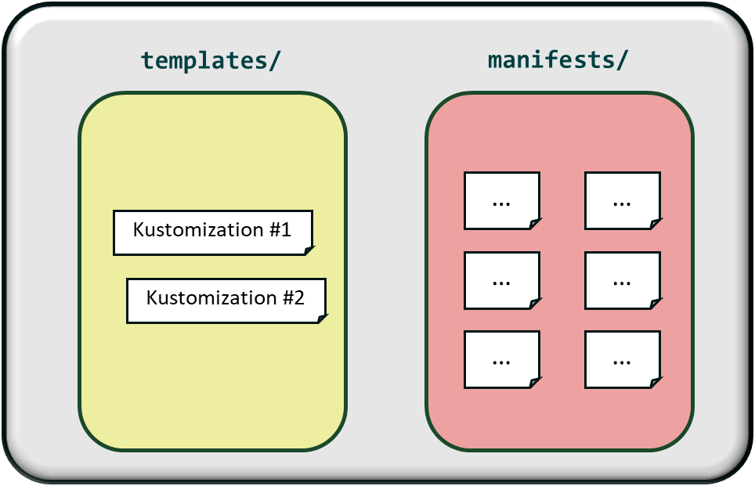
Application artifacts in OSM
OKA (OSM Kubernetes Application)
A complex OKA consists of multiple components,
each with its manifests and templates
observability-tools/
├── elasticsearch
│ ├── manifests
│ │ ├── hr-client.yaml
│ │ ├── hr-data.yaml
│ │ └── hr-master.yaml
│ └── templates
│ └── kustomization.yaml
├── opensearch
│ ├── manifests
│ │ ├── hr-dashboard.yaml
│ │ ├── hr-fluentd.yaml
│ │ └── hr-jaeger.yaml
│ └── templates
│ └── kustomization.yaml
├── prometheus
│ ├── manifests
│ │ ├── preprovisioner
│ │ │ └── hr-preprovisioner.yaml
│ │ └── prometheus-grafana
│ │ ├── hr-grafana.yaml
│ │ └── hr-prometheus.yaml
│ └── templates
│ ├── ks-preprovisioner.yaml
│ └── ks-prometheus-grafana.yaml
├── sftp-server
│ ├── manifests
│ │ └── helmrelease.yaml
│ └── templates
│ └── ks-sftp-server.yaml
├── snmp-notifier
│ ├── manifests
│ │ └── helmrelease.yaml
│ └── templates
│ └── ks-snmp-notifier.yaml
└── model.yaml

Slide 15
Application artifacts in OSM
OKA (OSM Kubernetes Application)
In addition, an application could require different synchronization layers

Slide 16
Application artifacts in OSM
OKA (OSM Kubernetes Application)
App Blueprint
Pattern #1
KSU #1
Brick #1
Optional component:
Ingress
Type:
Basic
Brick #2
Type:
HelmRelease Set
Values per HR
KSU #2
. . .
Brick #N
. . .
. . .
KSU #N
Pattern #N

Slide 17
Application artifacts in OSM
Concepts
Brick: smallest deployable function
  A group of Kubernetes resources packaged as a deployable unit, typically managed by a Flux Kustomization
  All manifests within the same brick are synchronized together.
Pattern: generic blueprint of a component
  It lives in the sw-catalog repo (it actually refers to a templates folder).
  It is the reusable recipe
KSU: “Kubernetes SW Unit”
  It is the deployment instance of a component in a specific environment.
  In the end, it translates to a folder in the fleet repo.
    fleet/<project>/<profile>/<ksu_folder>

Slide 18
Application artifacts in OSM
Concepts
File model.yaml includes:
  Structure of KSU, patterns and bricks
  Dependencies between bricks related to synchronization order
    Different bricks may synchronize concurrently or sequentially, depending on defined dependencies (e.g., a brick introducing new CRDs must synchronize before bricks that define resources based on those CRDs).
  Each brick may define its own health and readiness conditions, that are validated by OSM to determine global application health.
Example of file model.yaml

Slide 19
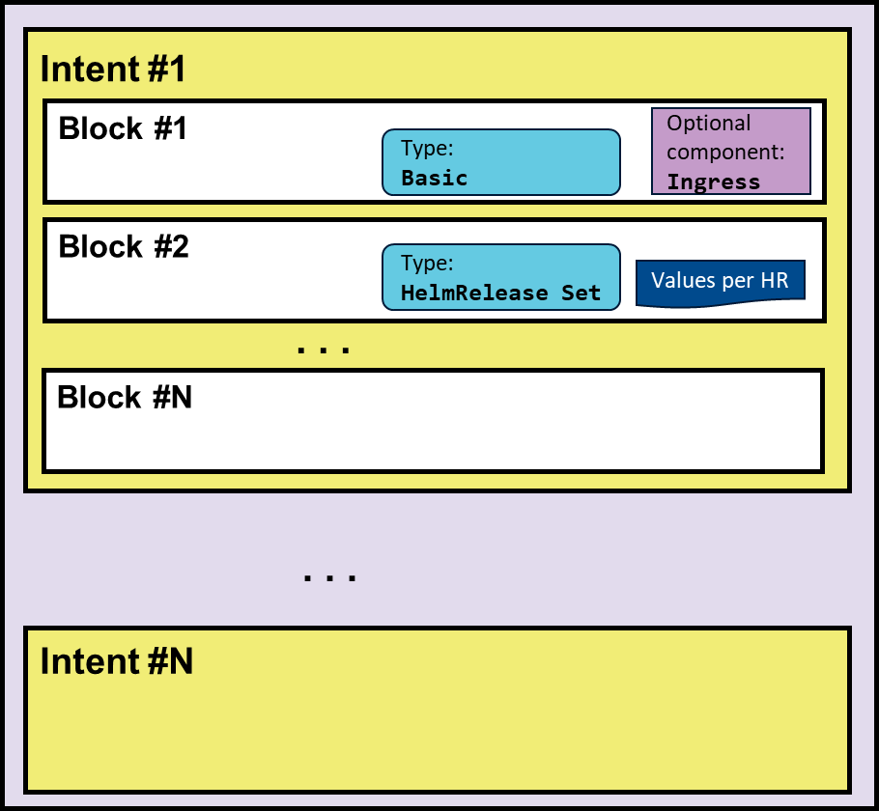
App Instantiation in OSM
OSM’s Modelling
Resources @ Profile (fleet repo)
OSM
App Instance
Kustomization #1
Instantiation Parameters
KSU Instance #1
KSU Instance #2
Kustomization #2
App modelling
. . .
ConfigMap (generated)
KSU Instance #N
Encrypted Secret (generated)

Slide 20

Thank You !

